Slide 2
learn how to format name node on hadoop master
learn how to start all hadoop services.

Slide 3
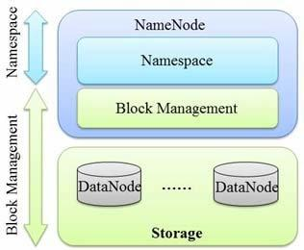
Introduction

Slide 4
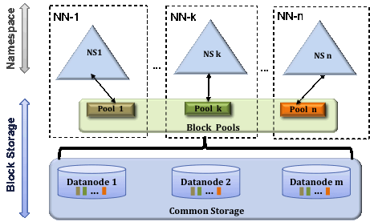
Multiple Namenodes/Namespaces

Slide 5
Federation Configuration
Daemon | Configuration Parameter
Namenode | dfs.namenode.rpc-address dfs.namenode.servicerpc-address dfs.namenode.http-address dfs.namenode.https-address dfs.namenode.keytab.file dfs.namenode.name.dir dfs.namenode.edits.dir dfs.namenode.checkpoint.dir dfs.namenode.checkpoint.edits.dir
Secondary Namenode | dfs.namenode.secondary.http-address dfs.secondary.namenode.keytab.file
BackupNode | dfs.namenode.backup.address dfs.secondary.namenode.keytab.file

Slide 6
Format a namenode
hdfs namenode -format [-clusterId <cluster_id>]

Slide 7
Format a namenode
# su Hadoop
$ cd /opt/hadoop/hadoop
$ bin/hadoop namenode -format

Slide 8
Reason for Hadoop Namenode - Format
By default the namenode location will be at "/tmp/hadoop-myuser/dfs/name“
While you formatting the namenode, this file location was cleared.

Slide 9
Reason for Hadoop Namenode - Format
To change the namenode location add the follwing properties At hdfs-site.xml
<property>
<name>dfs.namenode.name.dir</name>
<value>file:/search/data/dfs/namenode</value>
</property>
<property>

Slide 10
Reason for Hadoop Namenode - Format
To change the namenode location add the follwing <name>dfs.datanode.data.dir</name>
<value>file:/search/data/dfs/datanode</value>
</property>

Slide 11
Starting Hadoop Services.
cd ~/hadoop/sbin
start-dfs.sh
  stop-dfs.sh
  start-mapred.sh
  stop-mapred.sh
  start-all.sh
  stop-all.sh

Slide 12
Starting Hadoop Services.
cd ~/hadoop/sbin
  start-dfs.sh
  stop-dfs.sh
  start-mapred.sh
  stop-mapred.sh
  start-all.sh
  stop-all.sh

Slide 13
Starting Hadoop Services.
cd ~/hadoop/sbin
  start-dfs.sh
  stop-dfs.sh
  start-mapred.sh
  stop-mapred.sh
  start-all.sh
  stop-all.sh

Slide 14
Starting Hadoop Services.
cd ~/hadoop/sbin
  start-dfs.sh
  stop-dfs.sh
  start-mapred.sh
  stop-mapred.sh
  start-all.sh
  stop-all.sh

Slide 15
Starting Hadoop Services.
cd ~/hadoop/sbin
  start-dfs.sh
  stop-dfs.sh
  start-mapred.sh
  stop-mapred.sh
  start-all.sh
  stop-all.sh

Slide 16
Starting Hadoop Services.
cd ~/hadoop/sbin
  start-dfs.sh
  stop-dfs.sh
  start-mapred.sh
  stop-mapred.sh
  start-all.sh
  stop-all.sh

